Slide 1
I can do it list
Presented by Olga Maunsell

Slide 2
MVP + Extensions

Slide 3
Olga’s Extensions !
Menu option to allow different filters of task list
Notes:
CRUD for transactions and budgets. CRU for vendors and tags. No delete allowed

Slide 4
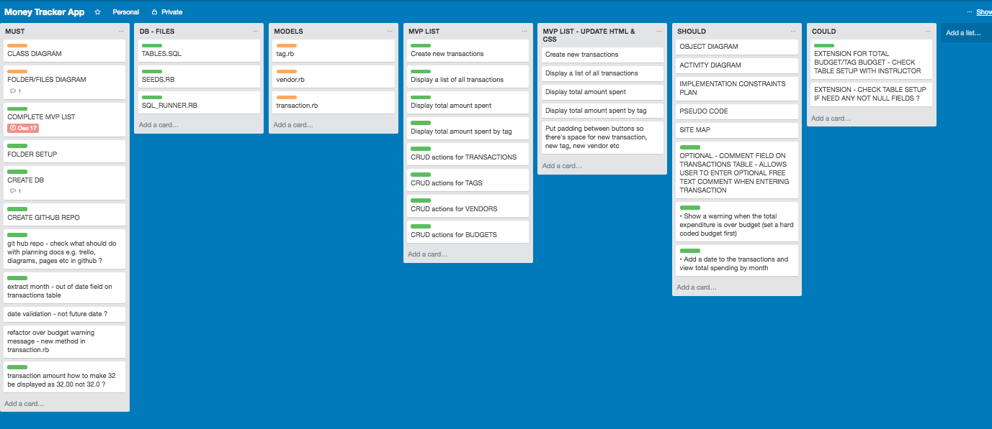
Planning – Trello Board

Slide 5
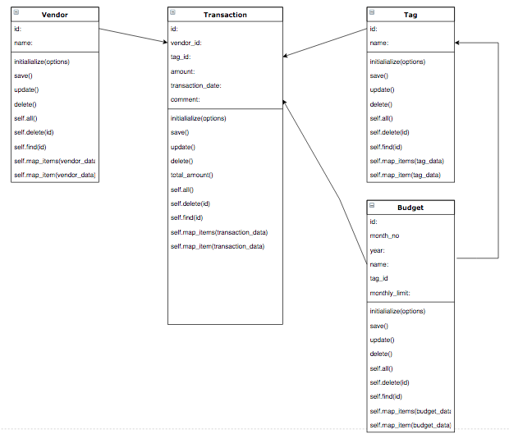
Class Diagram

Slide 6
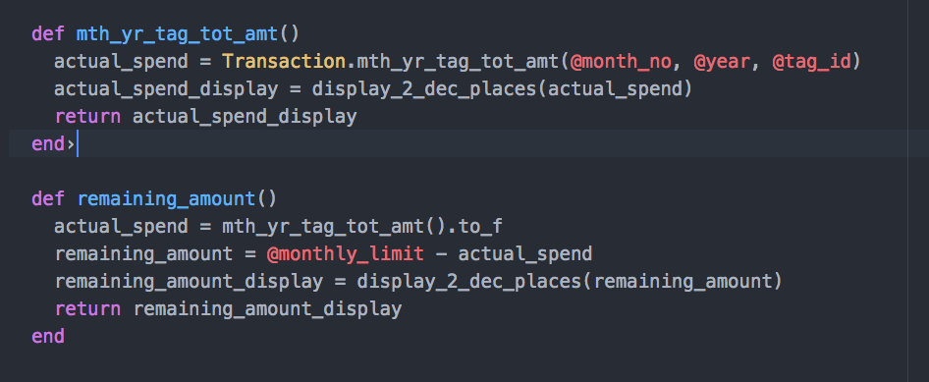
Budgets – Display actual/budget amount by month – Budget Class methods

Slide 7
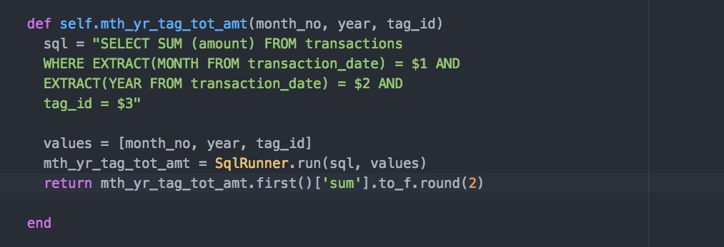
Budgets – Display actual amount by month – Transaction Class method

Slide 8
Future Functionality – Version 2 !!
Improve the styling
Update the transactions screen to provide a current month summary by tag of actual spend, budget and remaining amount (this info currently can be viewed via the tag budget screen)
Provide a chart or graph screen which provides a comparison of monthly spending with colour coding of red/amber/green to show where the user has overspent their monthly budget
Provide filters/searches to restrict the list of transactions by date/vendor/tag

Slide 9

Lessons learned
Everything takes longer than expected
I know more about manipulating data with dates using months and years !

Slide 10

Now here’s the demo !

